Slide 1
Locate tools for Landscapers

Slide 2
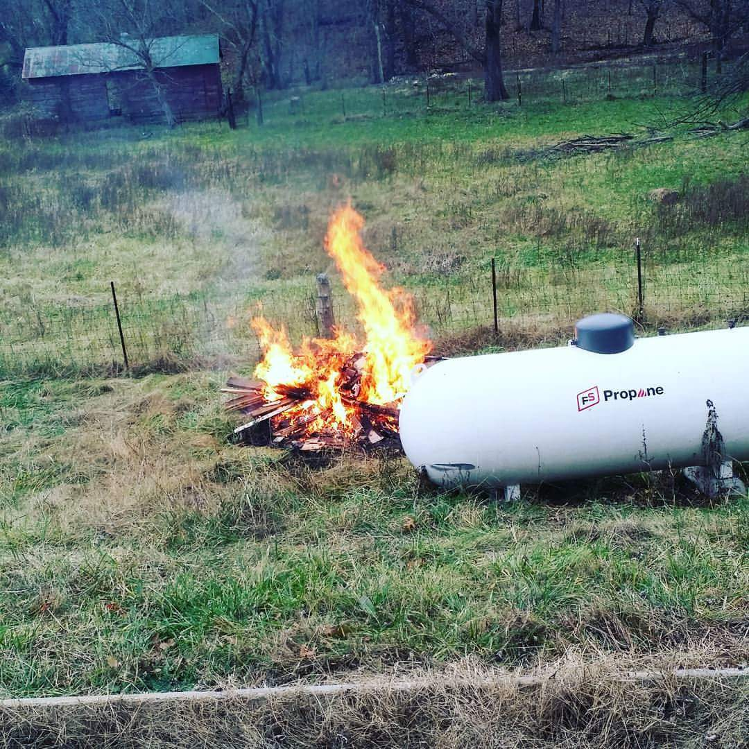
Hazard Identification

Slide 3
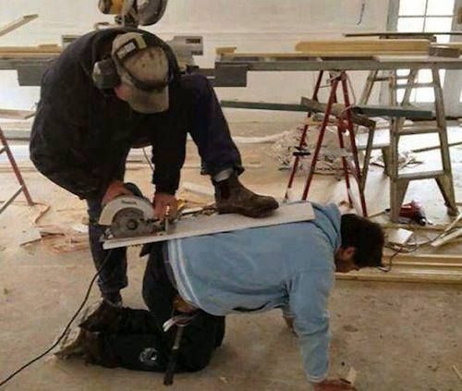
Hazard Identification

Slide 4
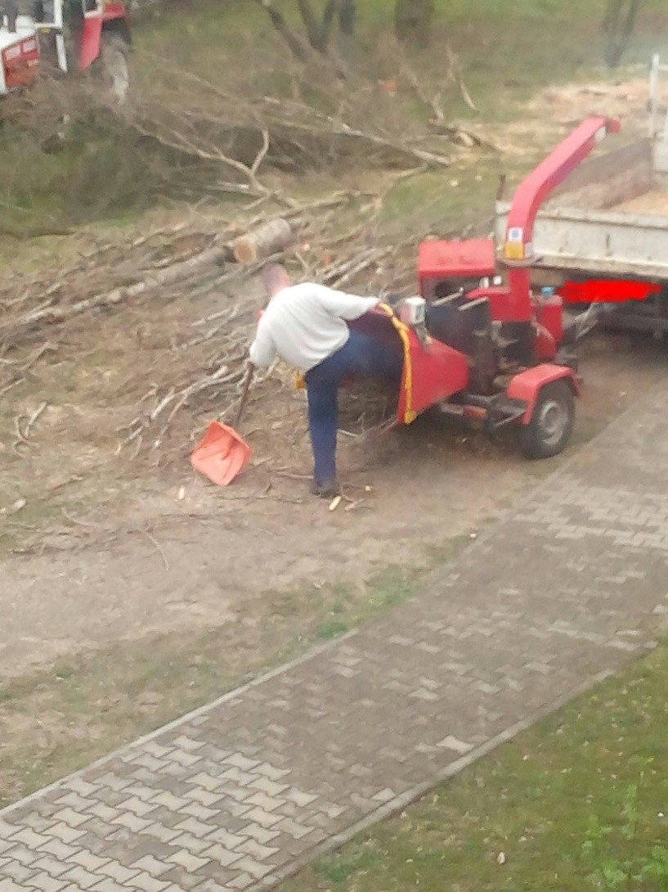
Hazard Identification

Slide 5
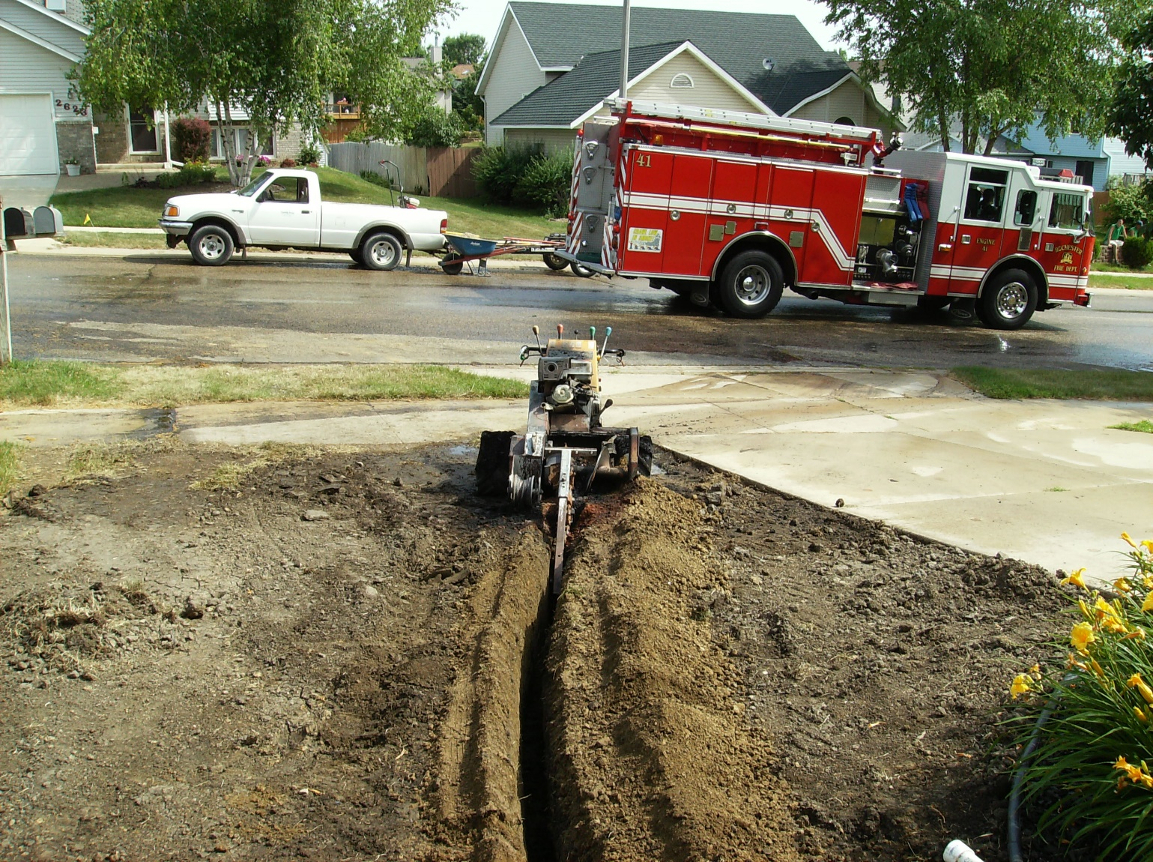
Hazard Identification

Slide 6
By the Numbers

Slide 7
REQUEST
Gas
Communications
Hydro
Water
Sewer
Damage Prevention Technician
(DPT)
REVIEW
RECEIVE
Notes:
Flowchart is animated,
Happens on the click,
Request
Receive
Review

Slide 8
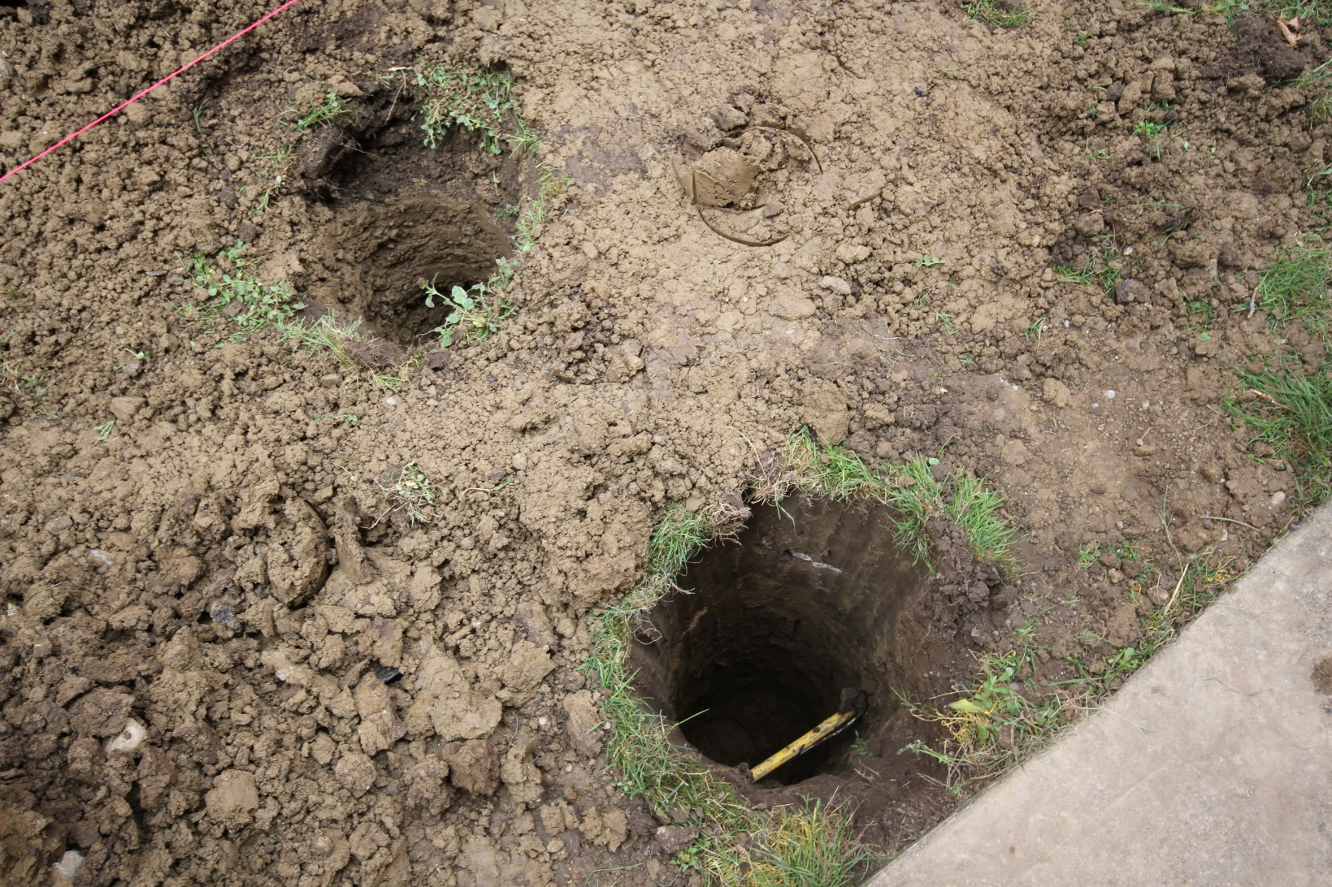
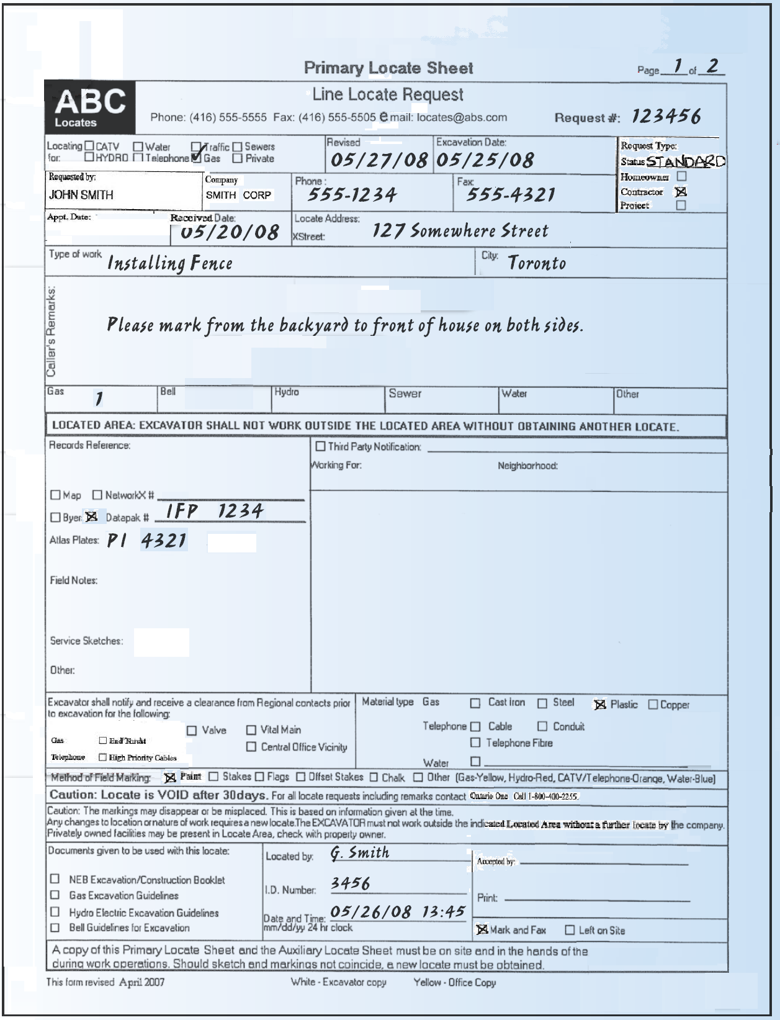
The Result

Slide 9
Requesting Locates

Slide 10
Who Should Get A Locate

Slide 11
What we’re going to ask
Who are you?
Where are you planning on digging?
What do you plan on doing?
When do you plan on doing it?

Slide 12
Requesting
Call
1-800-400-2255
Click
www.on1call.com
3rd Party Applications
Like UExcavate or Sundex or build your own!

Slide 13
Changes in 2017
Using the map to select who will be notified
Measurement tool
Civic address pin drop
Map overlays for project work submissions that require more than one attachment
Making the reason why a ticket goes to agent review more clear
Notes:
Right now, the way we select who gets notified is by the street, cross street and corner lot questions. We can filter based on what our members ask us to do but effectively that’s why you don’t get Toronto Water notified when digging in Timmins. The map we have you select is for reference only.
This December we have a big change coming. In December, that map selection will also be used to tell our system who to notify.
So this year is a whole dig season about learning to use the map selection tool. Up until December, you get to practice.
Now we’ve already heard since turning this requirement on you’d like us to have a measuring tool and addresses clearly visible on the map. We’re working on those and hope to have an update for you in July or August. At that time, we’re having another set of training programs available for you. Stay tuned.
Let’s talk about what we’ve seen and what you can do between now and December so you can get the most out of your one call ticket this year and be an expert when the map counts.

Slide 14
Transition tools
Free GIS Services:
Northumberland County
Hastings County GIS
Prince Edward County GIS
L&A GIS
Kingston GIS
Frontenac County GIS
Leeds & Grenville GIS

Slide 15
Best Practices
Show your work area three ways
Refer to fixed structures
Ex: From north fence to south fence and from front of house to rear fence
Use the online map selection
Outline your area in white when conditions permit
Provide lead time
Submit your locate and provide at least 5 business day’s notice
Members must make a reasonable attempt to respond within 5 business days

Slide 16
What you’ll get
ONTARIO ONE CALL Locate Request Confirmation Ticket #:2013298142 Reason Code:STANDARD Work to Begin Date: 07/24/2013 Time: 08:00:00 AM WAP No: _______________________________________________________________________ CALLER INFORMATION SHANE HART Tel.:(226)338-8906 Ext: 0 SHANE HART Tel.:(226)338-8906 Ext: 0 HOMEOWNER Cell: WORK BEING DONE FOR: Fax: shanehart@me.com ALT CONTACT: Tel.:(318)674-0470 _______________________________________________________________________ DIG LOCATION City: GUELPH , WELLINGTON Community: GUELPH Address :75 To: Lot/Unit#: Street : SANDERSON DR Nearest Intersecting Street : MATTHEW DR Second Intersecting Street : Nb of Segments: 5 _______________________________________________________________________ Type of Work: FENCE Max Depth: 0.00 FT Machine Dig: X Hand Dig: X Public Property: Private Property: X Mark & Fax: Site Meet Req.: Area is Not Marked: X Area is Marked: Directional Drilling: Work Extent/Location: W1307161544190 FROM THE ROAD, IT'S THE LEFT SIDE OF THE HOUSE FOR ONE HOLE TO MAKE A GATE SO FROM THE EXISTING FENCE TO THE HOUSE. AFTER THAT, IT'S THE BACK LENGTH OF FENCE ATTACHING THE 2 BACK CURRENT FENCES SIDE, BACK Remarks: DEPTH UNKNOWN _______________________________________________________________________ The following utility owners have been notified of your proposed excavation site: BCOW01 G-TEL FOR BELL CANAD GHY01 G-TEL FOR GUELPH HYD ROGWAT01 CCS FOR ROGERS (ROGW UGOW01 G-TEL FOR UNION GAS These members have been removed due to the relocate: Note: -C = Cleared, -S = Supressed, -L = Lookup center cleared, -A = Alternate Locate, -R = Existing locate valid - maintain marks
Received from Ontario One Call after once your locate request has been processed
Excavator Confirmation holds a lot of information
Ticket Number & Dates
Caller Information
Dig Location Details (Address)
Work Details (Type of Work)
Utility Owners Notified

Slide 17
Checklist
The following utility owners have been notified of your proposed excavation site:
UGOE01 – PROMARK FOR UNION GAS
H3BOE01 – PROMARK FOR HYDRO ONE
H3BOE01 – PROMARK FOR HYDRO ONE
BAOE01 – PROMARK FOR BELL ALIANT
COGE01 – C – NHC FOR COGECO CABLE
LXA01 – C – COUNTY OF LENNOX AND ADDINGTON
These members have been removed due to the relocate: Note: -C = Cleared, -S = Supressed, -L = Lookup center cleared,
-A = Alternate Locate, -R = Existing locate valid - maintain marks

Slide 18
Who is missing?
Federal Infrastructure
Provincial Infrastructure
First Nations Infrastructure
Private Infrastructure
Notes:
First three gaps are closing slowly.
Most injuries occur by contact with private infrastructure – specifically buried electrical lines from a house to a garage/barn/outbuilding or lighting in a commercial parking lot. Speak with the property owner and have them locate this infrastructure for you. You may also wish to investigate getting a private locator.

Slide 19
The Locate
Gas
Communications
Hydro
Water
Sewer

Slide 20
Decision Time
Notified utilities are required to make a reasonable attempt at a response within
5 business days.
That response must be
Provide a locate
Provide a clearance
Renegotiate a new deadline to provide 1 or 2

Slide 21
Clearance
Means: This utility is not worried about your activity.
Requirements around “Clearance”
Must return paperwork
Paperwork must contain
The word “Clear”
The date of the clearance
Any conditions on that clearance

Slide 22
Locate
Means: This utility is worried about your activity.
Requirements around “Locate”
Must place some kind of marking on the ground
Must return paperwork
Paperwork must contain
A map of what was located
The date of the locate
Any instructions on how to dig safely around the located utility

Slide 23
Problems?
Start by contacting the utility or locator
If they do not give you the response you need, contact Ontario One Call’s compliance division to have your situation escalated.
compliance@on1call.com
1-800-400-2255

Slide 24
RECEIVE and REVIEW

Slide 25
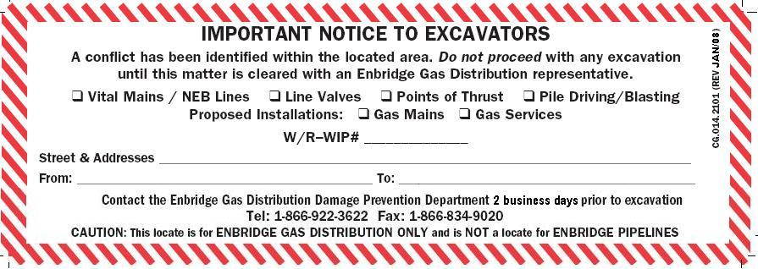
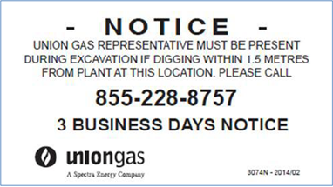
Special Instruction
Some locates contain a notice to the excavator to contact the utility for more information
Be sure to review thoroughly

Slide 26
Review the sketch
Is your planned area within the area indicated in the locate request?
Do you understand the information in the locate?

Slide 27
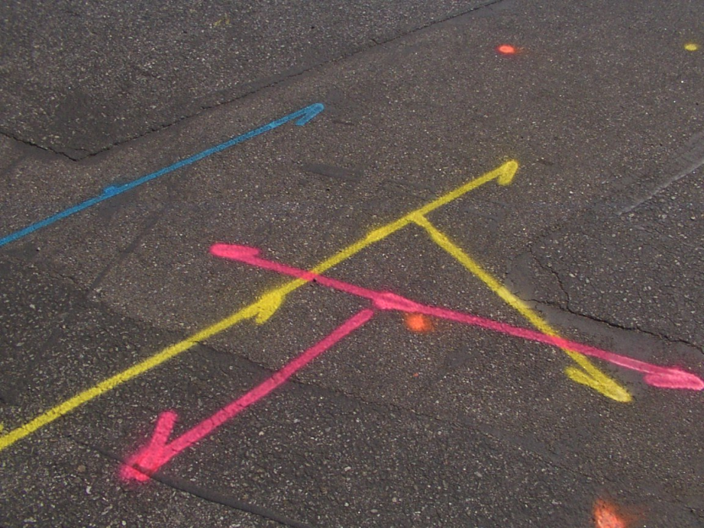
Match Paint to Paper

Slide 28
Problems?
Start by contacting the utility or locator.
If they do not give you the response you need, contact Ontario One Call’s compliance division to have your issue escalated
compliance@on1call.com
1-800-400-2255

Slide 29
Dig Safely
Notes:
You should be armed with everything you need to dig safely!
Remember, if you dig and hit something, call 911 or the utility.

Slide 30
Thank you

